Slide 1
پردازش تصویر و مقدمه ای بر یادگیری ماشین

Slide 2
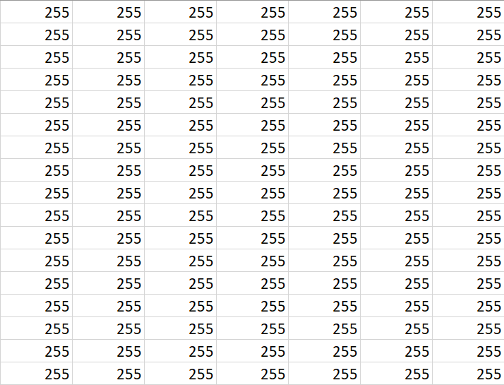

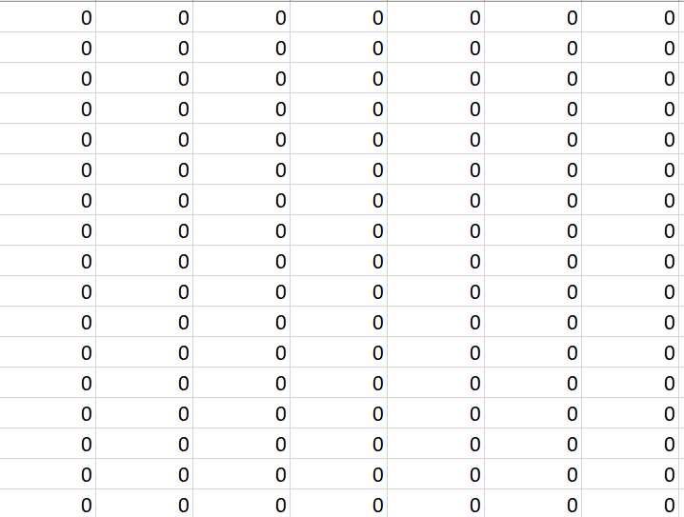

مقدمه:
یادآوری :

Slide 3
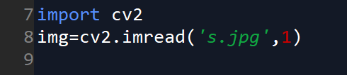
باز کردن تصویر در Open CV:
Imread()
Syntax: cv2.imread(path, flag)
Parameters: path: A string representing the path of the image to be read. flag: It specifies the way in which image should be read. It’s default value is cv2.IMREAD_COLOR
Return Value: This method returns an image that is loaded from the specified file.

Slide 4
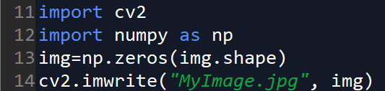
ساخت یک تصویر در Open CV :
Imwrite()
Imwrite()
Syntax: cv2.imwrite(filename, image)
Parameters: filename: A string representing the file name. The filename must include image format like .jpg, .png, etc. image: It is the image that is to be saved.
Return Value: It returns true if image is saved successfully.
np.zeros()

Slide 5
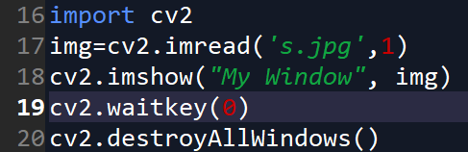
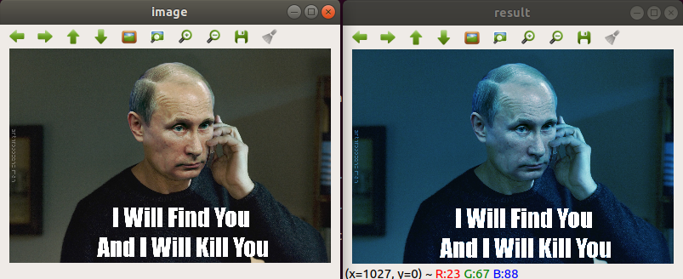

نمایش یک تصویر در Open CV :
Imshow()
Syntax: cv2.imshow(window_name, image)
Parameters: window_name: A string representing the name of the window in which image to be displayed. image: It is the image that is to be displayed.
Return Value: It doesn’t returns anything.

Slide 6

cv2.waitkey()
Window will wait until you press a key

Slide 7
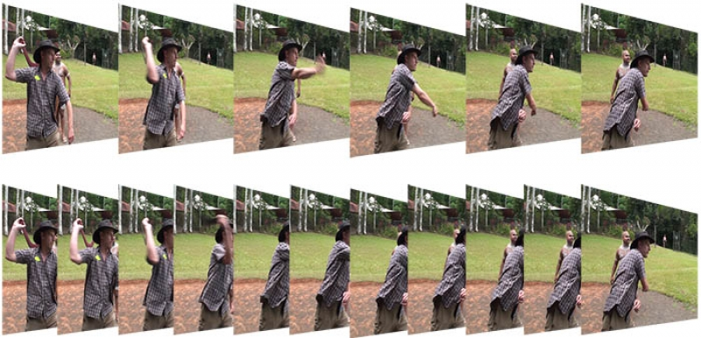
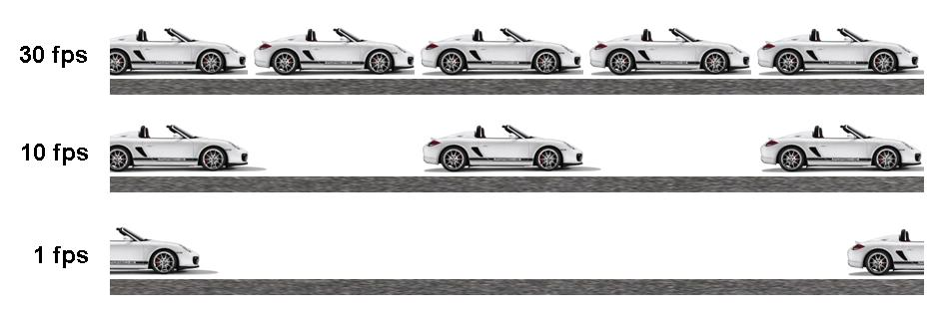
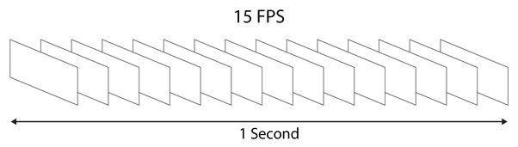
مقدمه :
Frame چیست ؟

Slide 8

باز کردن ویدیو در Open CV :
VideoCapture()
cv2.VideoCapture(0): Means first camera or webcam.
cv2.VideoCapture(1): Means second camera or webcam.
cv2.VideoCapture("file name.mp4"): Means video file

Slide 9
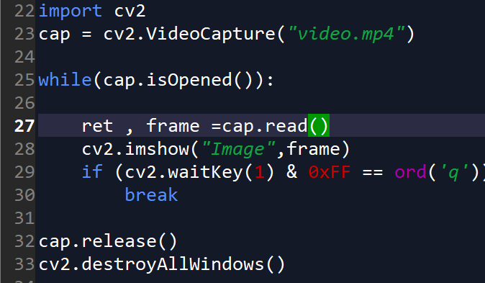
نشان دادن ویدیو در Open CV:
هر فریم را نشان میدهیم

Slide 10

رسم اشکال هندسی Open CV :
رسم خط :
Syntax: cv2.line(image, start_point, end_point, color, thickness)
Parameters: image: It is the image on which line is to be drawn. start_point: It is the starting coordinates of line. The coordinates are represented as tuples of two values i.e. (X coordinate value, Y coordinate value). end_point: It is the ending coordinates of line. The coordinates are represented as tuples of two values i.e. (X coordinate value, Y coordinate value). color: It is the color of line to be drawn. For BGR, we pass a tuple. eg: (255, 0, 0) for blue color. thickness: It is the thickness of the line in px.
Return Value: It returns an image

Slide 11
رسم اشکال هندسی Open CV :
رسم فلش :
Syntax: cv2.circle(image, center_coordinates, radius, color, thickness)
Parameters: image: It is the image on which circle is to be drawn. center_coordinates: It is the center coordinates of circle. The coordinates are represented as tuples of two values i.e. (X coordinate value, Y coordinate value). radius: It is the radius of circle. color: It is the color of border line of circle to be drawn. For BGR, we pass a tuple. eg: (255, 0, 0) for blue color. thickness: It is the thickness of the circle border line in px. Thickness of -1 px will fill the rectangle shape by the specified color.
Return Value: It returns an image.

Slide 12
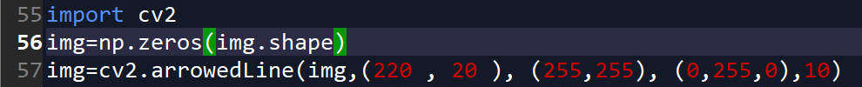
رسم اشکال هندسی Open CV :
Syntax: cv2.arrowedLine(image, start_point, end_point, color[, thickness[, line_type[, shift[, tipLength]]]])
Parameters: image: It is the image on which line is to be drawn. start_point: It is the starting coordinates of line. The coordinates are represented as tuples of two values i.e. (X coordinate value, Y coordinate value). end_point: It is the ending coordinates of line. The coordinates are represented as tuples of two values i.e. (X coordinate value, Y coordinate value). color: It is the color of line to be drawn. For BGR, we pass a tuple. eg: (255, 0, 0) for blue color. thickness: It is the thickness of the line in px. line_type: It denotes the type of the line for drawing. shift: It denotes number of fractional bits in the point coordinates. tipLength: It denotes the length of the arrow tip in relation to the arrow length. Return Value: It returns an image.
رسم دایره :

Slide 13
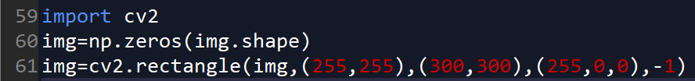
رسم اشکال هندسی Open CV :
رسم مربع :
Syntax: cv2.rectangle(image, start_point, end_point, color, thickness)
Parameters: image: It is the image on which rectangle is to be drawn. start_point: It is the starting coordinates of rectangle. The coordinates are represented as tuples of two values i.e. (X coordinate value, Y coordinate value). end_point: It is the ending coordinates of rectangle. The coordinates are represented as tuples of two values i.e. (X coordinate value, Y coordinate value). color: It is the color of border line of rectangle to be drawn. For BGR, we pass a tuple. eg: (255, 0, 0) for blue color. thickness: It is the thickness of the rectangle border line in px. Thickness of -1 px will fill the rectangle shape by the specified color.
Return Value: It returns an image.

Slide 14
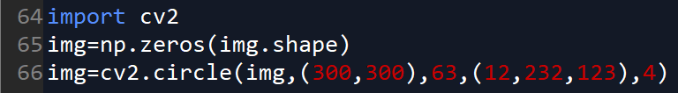
رسم اشکال هندسی Open CV :
رسم مستطیل :
Syntax: cv2.circle(image, center_coordinates, radius, color, thickness)
Parameters: image: It is the image on which circle is to be drawn. center_coordinates: It is the center coordinates of circle. The coordinates are represented as tuples of two values i.e. (X coordinate value, Y coordinate value). radius: It is the radius of circle. color: It is the color of border line of circle to be drawn. For BGR, we pass a tuple. eg: (255, 0, 0) for blue color. thickness: It is the thickness of the circle border line in px. Thickness of -1 px will fill the rectangle shape by the specified color.
Return Value: It returns an image.

Slide 15
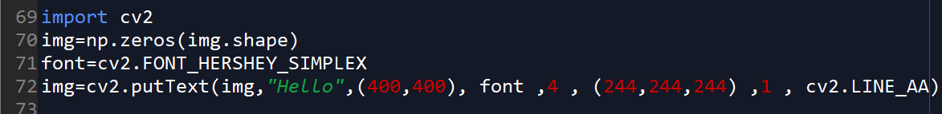
نوشتن روی عکسOpen CV :
نوشتن متن :
Parameters: image: It is the image on which text is to be drawn. text: Text string to be drawn. org: It is the coordinates of the bottom-left corner of the text string in the image. The coordinates are represented as tuples of two values i.e. (X coordinate value, Y coordinate value). font: It denotes the font type. Some of font types are FONT_HERSHEY_SIMPLEX, FONT_HERSHEY_PLAIN, , etc. fontScale: Font scale factor that is multiplied by the font-specific base size. color: It is the color of text string to be drawn. For BGR, we pass a tuple. eg: (255, 0, 0) for blue color. thickness: It is the thickness of the line in px. lineType: This is an optional parameter.It gives the type of the line to be used. bottomLeftOrigin: This is an optional parameter. When it is true, the image data origin is at the bottom-left corner. Otherwise, it is at the top-left corner.
Return Value: It returns an image.

Slide 16
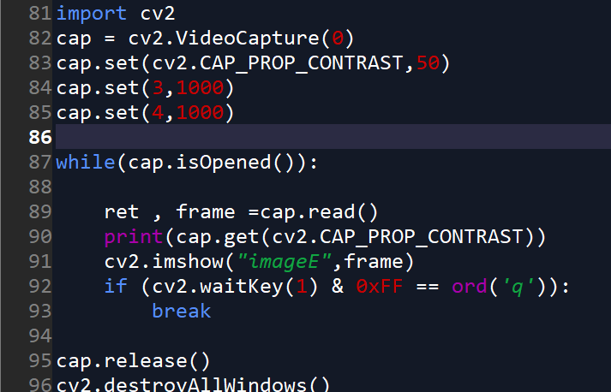
تنظیم کردن پارامتر های دوربین:
Height and width
تعداد زیادی پارامتر وجود دارد
https://docs.opencv.org/3.4/d4/d15/group__videoio__flags__base.html

Slide 17
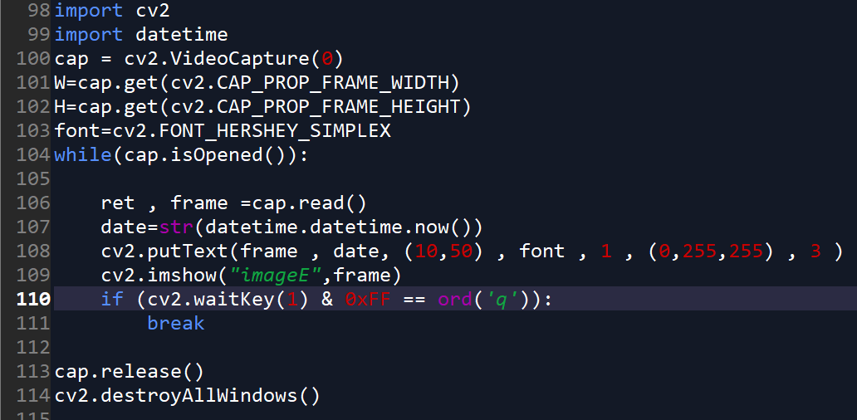
مثال :
نشان دادن زمان و تاریخ Open CV :

Slide 18
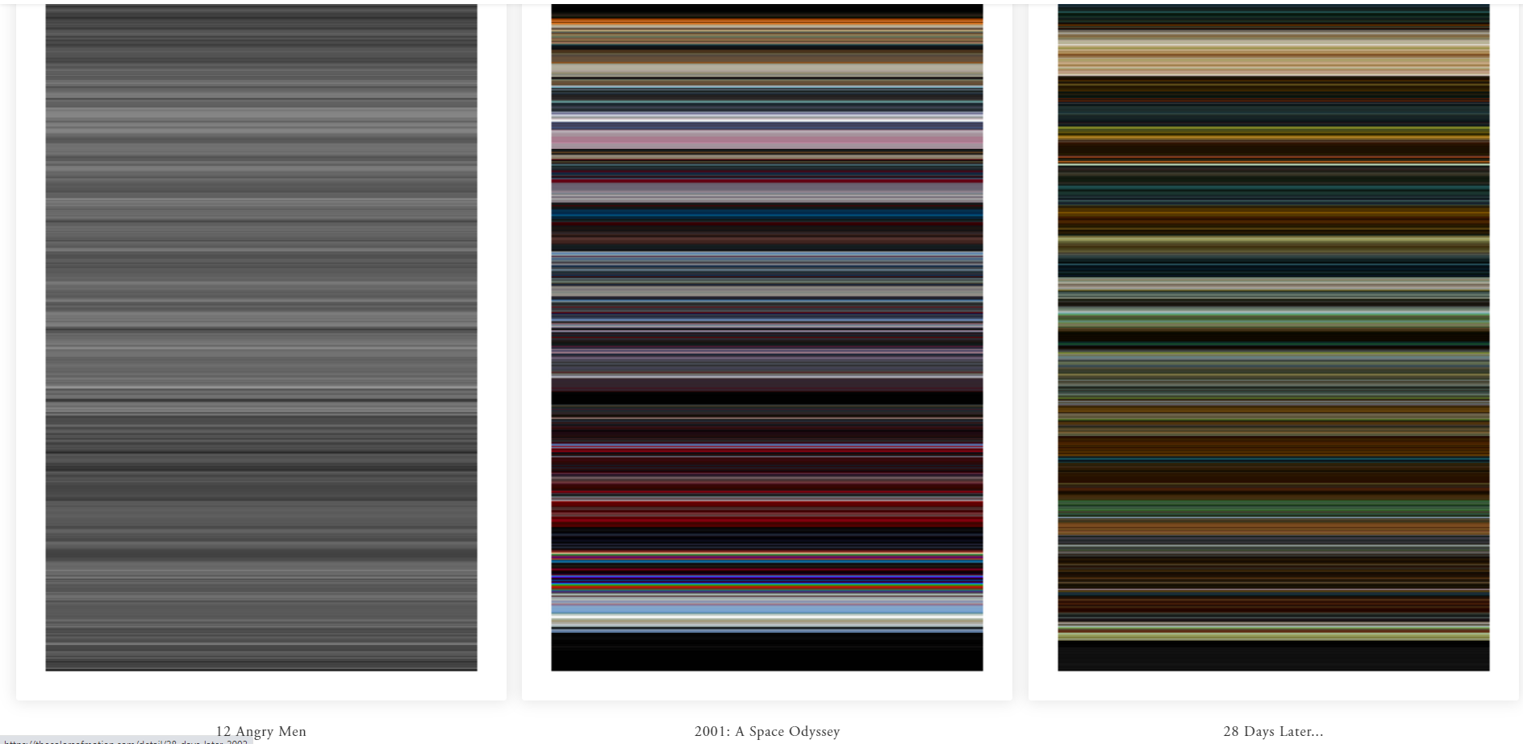
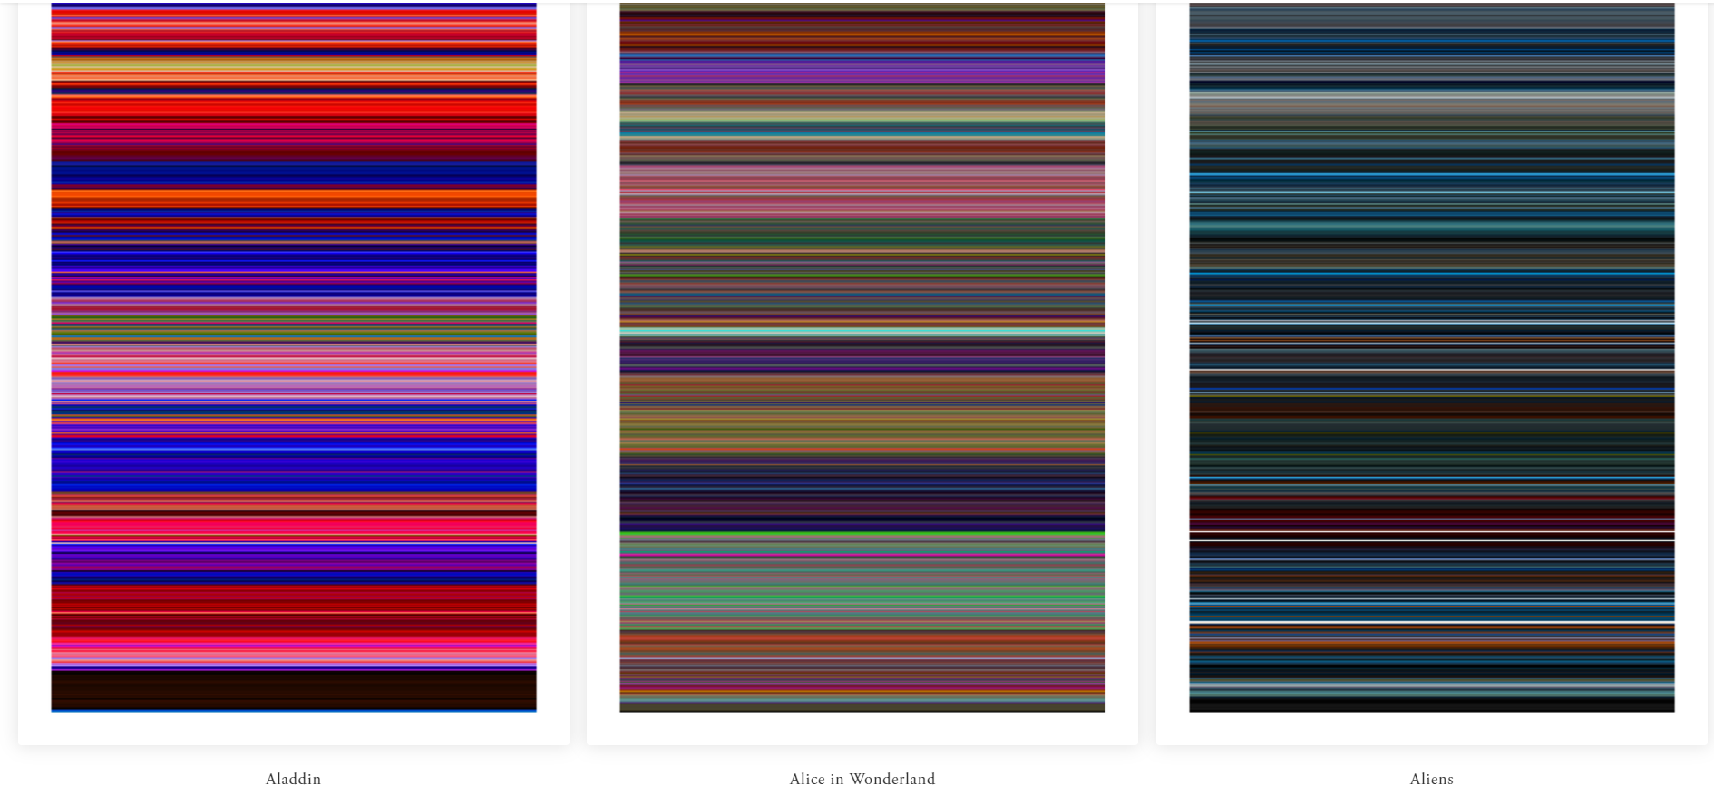
تمرین :
The Colors of motion
https://thecolorsofmotion.com/

